Slide 1
Chapter 5 Measures of Variability

Slide 2
Measuring Variability
Central Tendency
Numbers that describe what is typical or average (central) in a distribution
Measures of Variability
Numbers that describe diversity or variability in the distribution

Slide 3
Two Ways to Summarize a Distribution
The two measures help summarize a distribution without looking at each score
Measures of central tendency
tell you about typical scores
Measures of variation
reveal how far, from the typical score, the distribution tends to vary

Slide 4
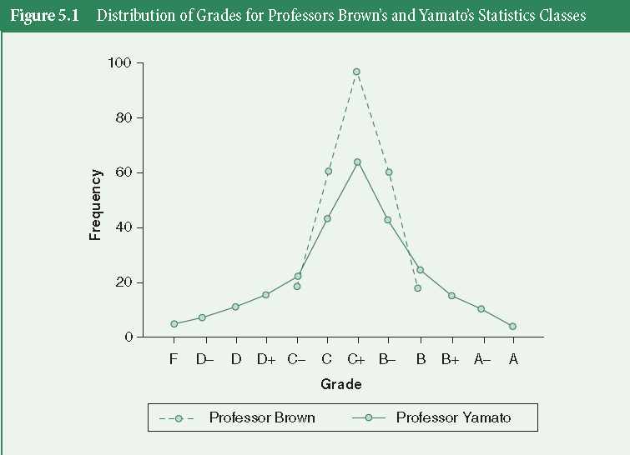
Measuring Variability
Notice that both distributions have the same mean, yet they are shaped differently

Slide 5
Index of Qualitative Variation
A measure of variability for nominal variables
Based on the ratio of the total number of differences in the distribution to the maximum number of possible differences within the same distribution

Slide 6
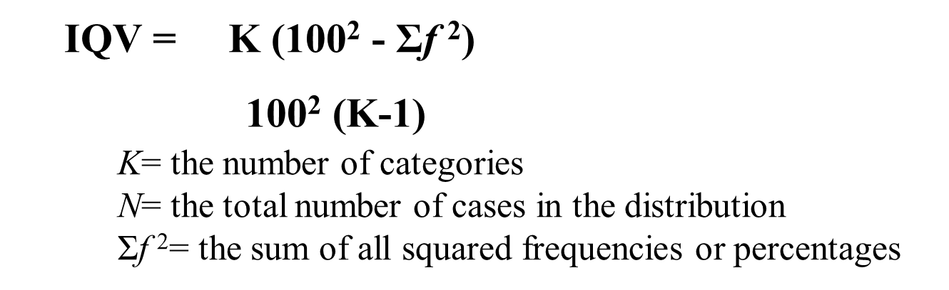
Index of Qualitative Variation

Slide 7
Index of Qualitative Variation
The IQV is a single number that expresses the diversity of a distribution
The IQV ranges from 0 to 1
An IQV of 0 would indicate that the distribution has NO diversity at all
An IQV of 1 would indicate that the distribution is maximally diverse

Slide 8
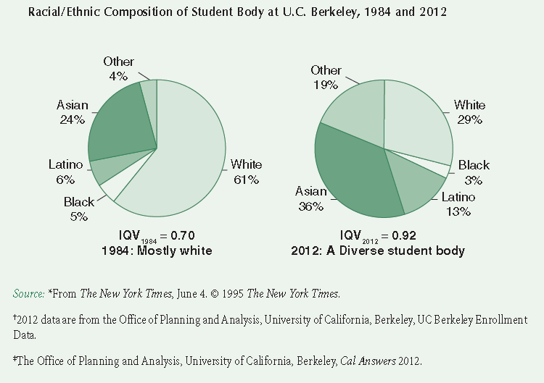
Statistics in Practice

Slide 9
The Range
A measure of variation in interval-ratio variables.
It is the difference between the highest (maximum) and the lowest (minimum) scores in the distribution
Range = Highest score – Lowest score

Slide 10
Exercise: The Range for Age
Let’s assume the oldest person in this class is 52.
Let’s also assume the youngest person in this class is 19.
What is the age range for this class?

Slide 11
Interquartile Range
A measure of variation for interval-ratio data
Indicates the width of the middle 50 percent of the distribution and is defined as the difference between the lower and upper quartiles
IQR = Q3 – Q1
Q3 = 75th percentile
Q1 = 25th percentile

Slide 12
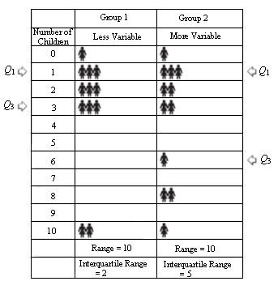
The Range and IQR
These values fall together closely
Shows greater variability
Yet the ranges are equal!
Importance of the IQR

Slide 13
The Box Plot
A graphic device that visually presents:
the range
the IQR
the median
the quartiles
the minimum (lowest value) and the maximum (highest value)

Slide 14
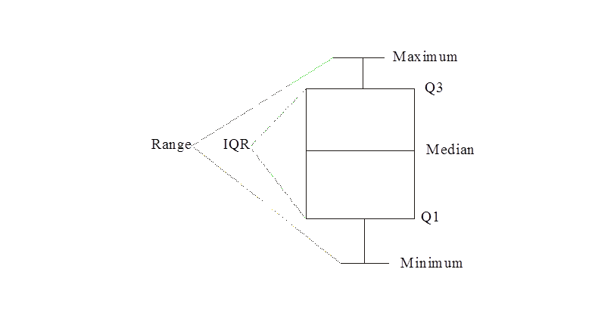
The Box Plot

Slide 15
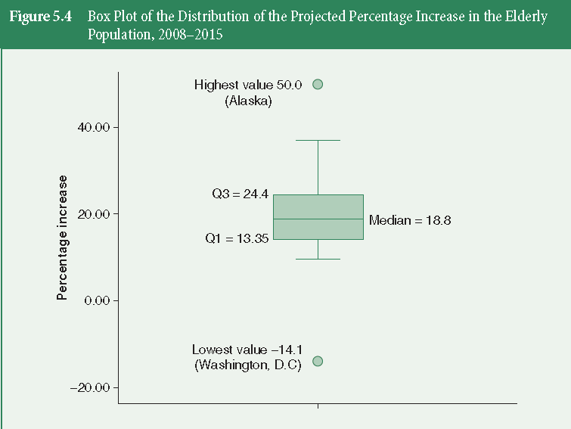
The Box Plot

Slide 16
Exercise: Boxplot for Range and IQR

Slide 17
Variance and Standard Deviation
You may want to know how much each score deviates from the overall average score
But reporting each deviation is overwhelming
We rely on a single measure to give a summary of how much all scores generally deviate from the average

Slide 18
Variance and Standard Deviation
These give you an estimate of how closely the scores cluster around the mean

Slide 19
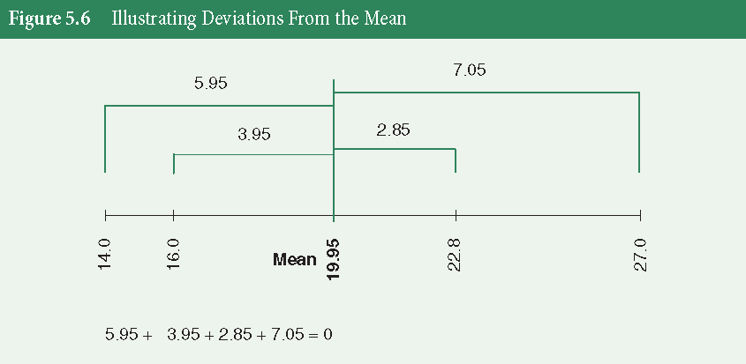
Deviation From the Mean
- -

Slide 20
Variance
A measure of variation for interval-ratio variables
It is the average of the squared deviations from the mean

Slide 21
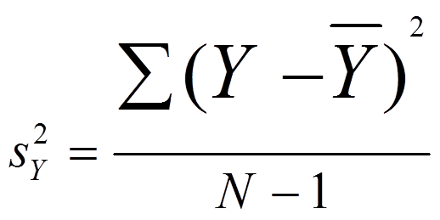
Variance

Slide 22
Standard Deviation
A measure of variation for interval-ratio variables
It is equal to the square root of the variance

Slide 23
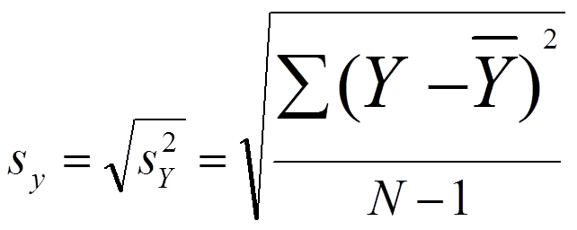
Standard Deviation

Slide 24
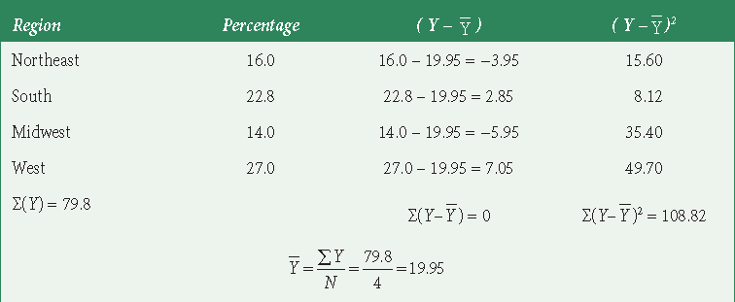
Deviation From the Mean
Table 5.8 Projected Percentage Change in the Elderly Population, 2008-2015, by Region, Deviation From the Mean, and Deviation From the Mean Squared

Slide 25
Choosing a Measure of Variability
Nominal variables
Only use IQV (not necessary)
Ordinal variables
Calculate the IQR (or IQV)
Interval-ratio variables
Use IQR, variance/standard deviation (or IQV)

Slide 26
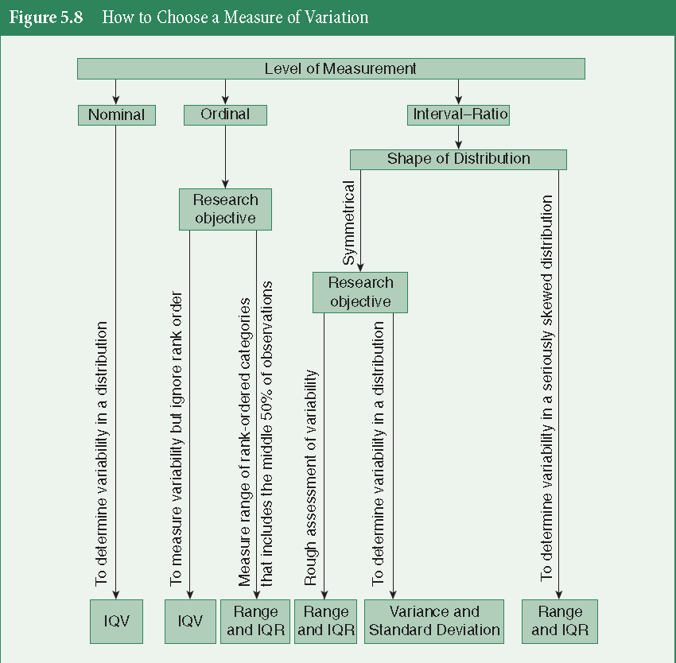
Choosing a Measure of Variability

Slide 27
Key Terms
Data
Dependent Variable
Descriptive Statistics
Dichotomous Variable
Empirical Research
Hypothesis
Independent Variable
Inferential Statistics
Interval-ratio
Measurement
Nominal Measurement

Slide 28
Key Terms
Index of Qualitative Variation
Interquartile Range
Measures of Variability
Range
Standard Deviation
Variance

